Slide 2
Lecture 30 DISCRETE STRUCTURE
SARA SHAFIQUE

Slide 3
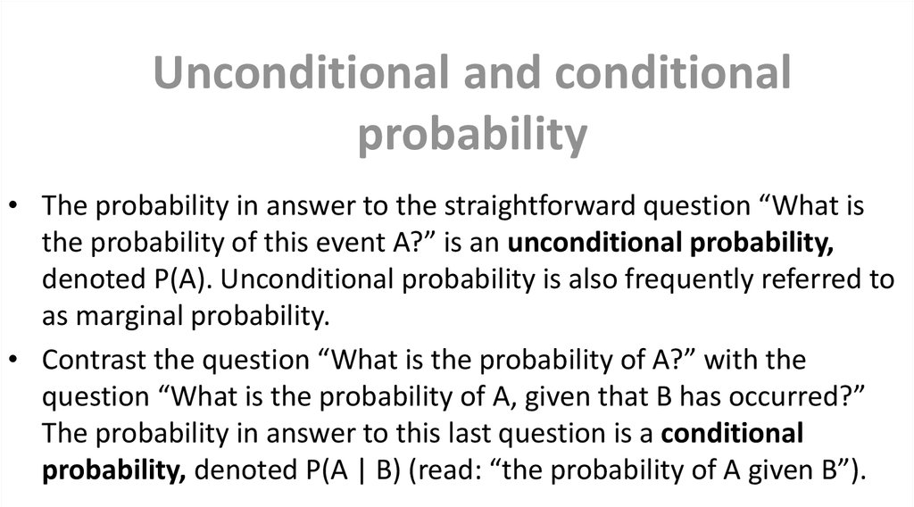


Slide 4
Conditional Probability
A conditional probability is one that is dependent on something before it happens.
An unconditional or independent is one that is unaffected by the previous action.
Unconditional Probability

Slide 5
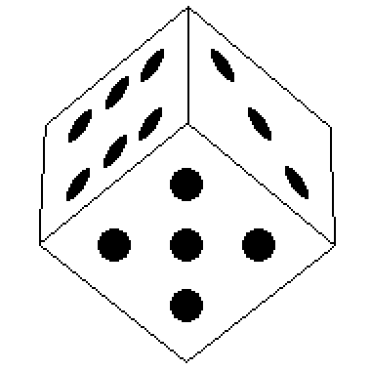

Examples of unconditional probabilities:
What is the probability of a dice rolling a 6?
What is the probability of landing a head on a coin toss?

Slide 6
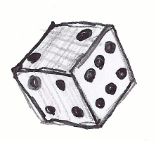

Single Event
A simple (or single) event is an event with a single outcome (only one "answer“ is possible).

Slide 7


Multiple Events
In probability, when two or more experiments are conducted together.
Independent Events
Dependent Events

Slide 8
Multiple Events - Independent Events
In probability, two events are independent if the incidence of one event does not affect the probability of the other event.
We call two events independent if the outcome of one of the events doesn't affect the outcome of another.
Example
For example, if we throw two dice, the probability of getting a 1 on the second dice is the same, no matter what we get with the first one- it's still 1/6.

Slide 9
Conditional Probability
A conditional probability, contrasted to an unconditional probability, is the probability of an event of which would affect or be affected by another event.
In other words, a conditional probability, as the name implies, comes with a condition.
Examples of conditional probabilities:
What is the probability of rolling a 6 followed by a 4?
What is the probability that it is sunny today given that it rains tomorrow?

Slide 10
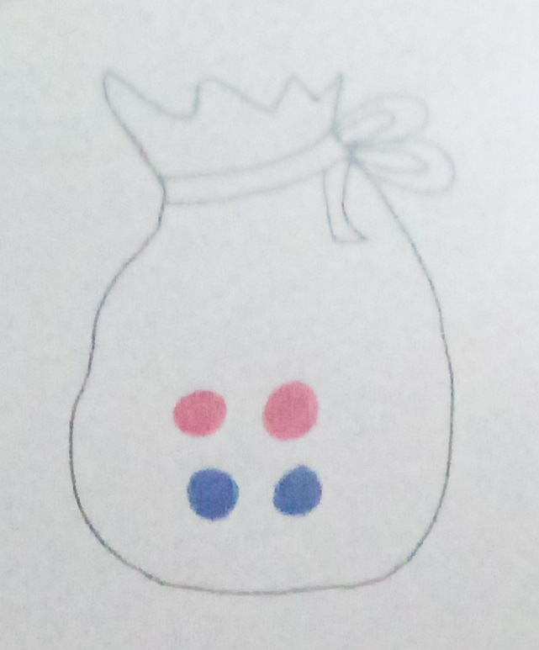
Multiple Events - Dependent Events
If the incidence of one event does affect the probability of the other event, then the events are dependent.
Example:
suppose we have a bag containing 2 red and 2 blue balls.

Slide 11
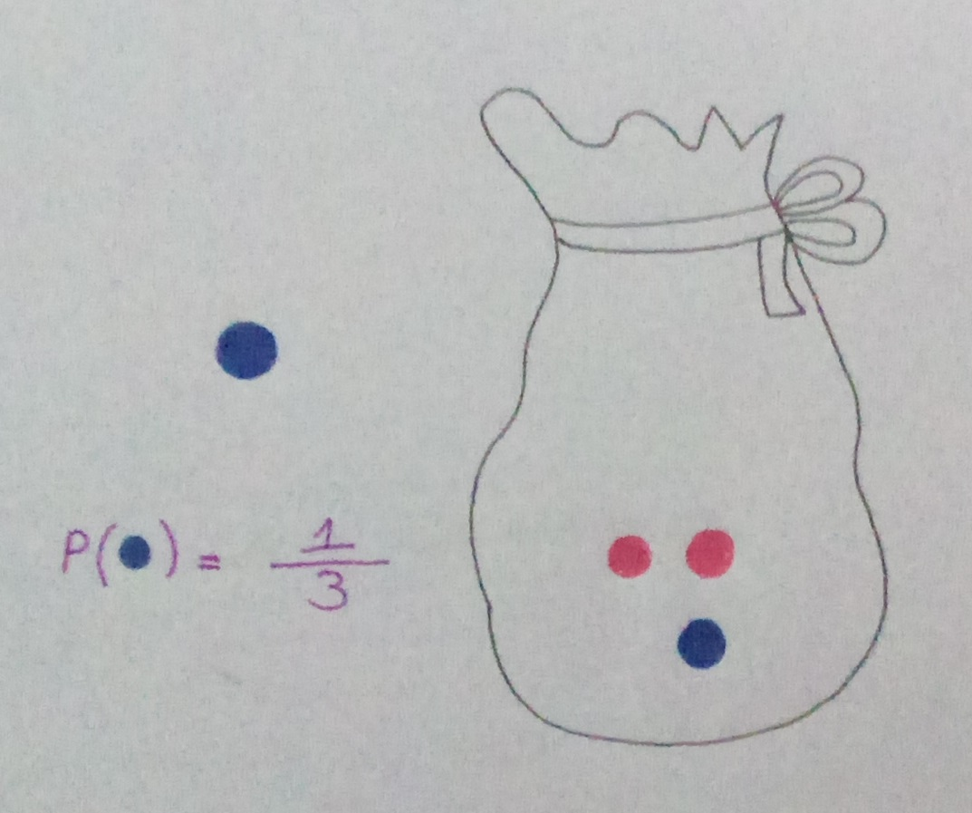
Multiple Events - Dependent Events (Example)
If we pick 2 balls out of the bag, the probability that the second is blue depends upon what the color of the first ball picked was.
If the first ball was blue, there will be 1 blue and 2 red balls in the bag when we pick the second ball.
So the probability of getting a blue is 1/3.

Slide 12
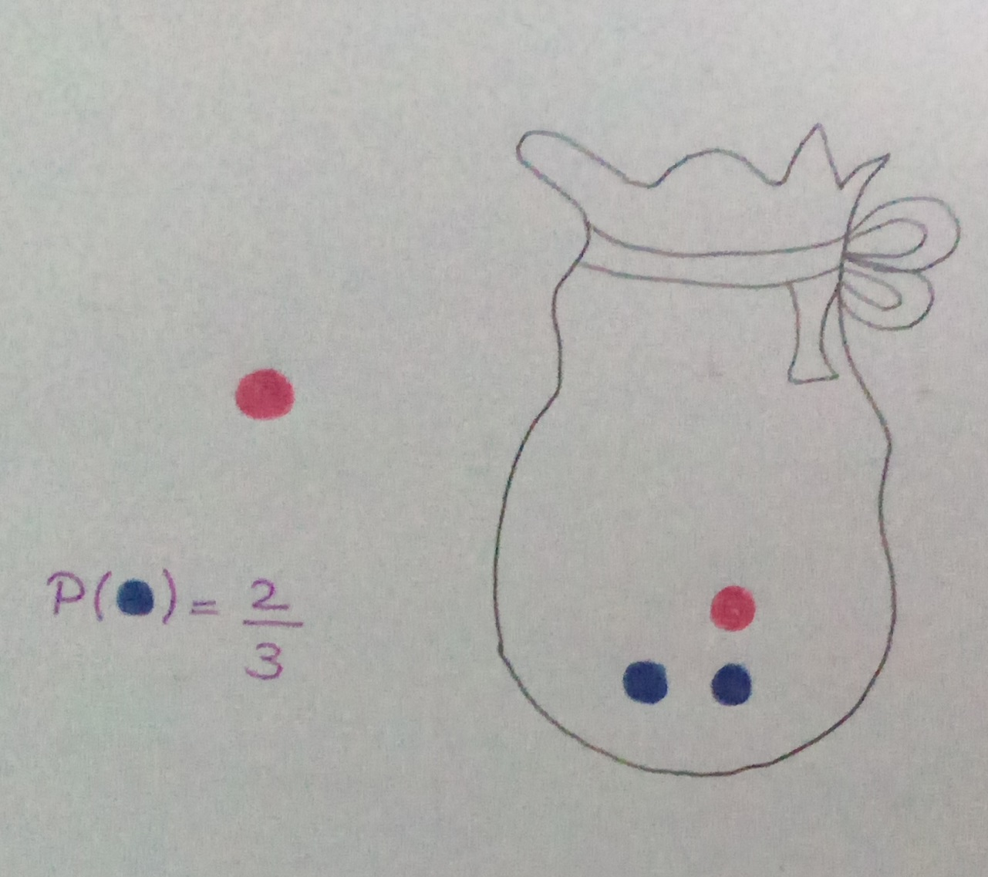
Multiple Events - Dependent Events (Example)
However, if the first ball was red, there will be 1 red and 2 blue balls left so the probability the second ball is blue is 2/3.
When the probability of one event depends on another, the events are dependent.

Slide 13
Probability Tree
Another way of representing 2 or more events is on a probability tree.

Slide 14
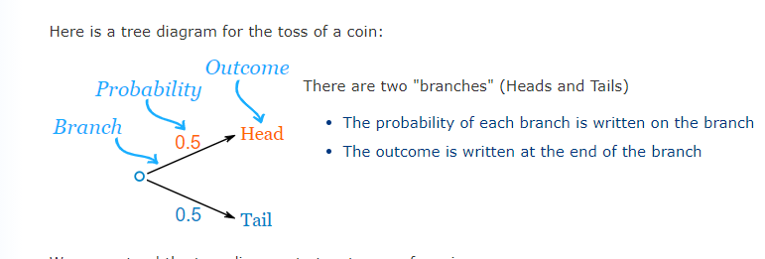
Probability Tree – Example

Slide 15
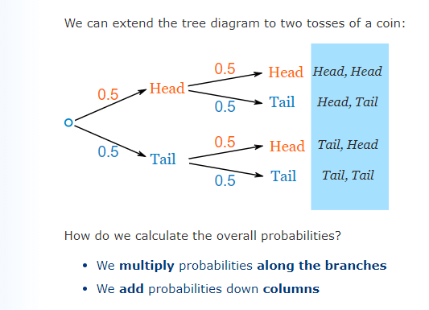
Probability Tree – Example

Slide 16
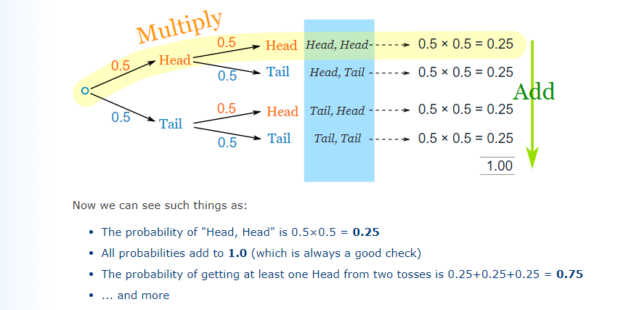
Probability Tree – Example

Slide 17
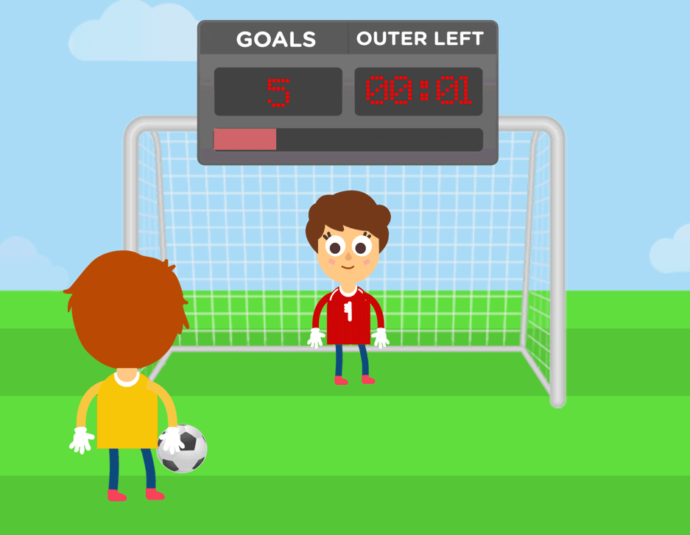
Probability Tree
That was a simple example using independent events (each toss of a coin is independent of the previous toss), but tree diagrams are really wonderful for figuring out dependent events (where an event depends on what happens in the previous event) like example given in next slide:

Slide 18
Probability Tree - Example: Soccer Game
You are off to soccer, and love being the Goalkeeper, but that depends who is the Coach today:
with Coach Sam the probability of being Goalkeeper is 0.5
with Coach Alex the probability of being Goalkeeper is 0.3
Sam is Coach more often ... about 6 out of every 10 games (a probability of 0.6).
So, what is the probability you will be a Goalkeeper today?

Slide 19
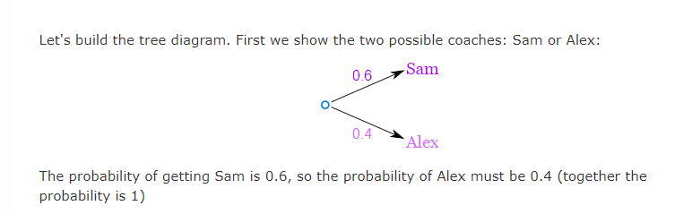
Probability Tree - Example: Soccer Game

Slide 20

Probability Tree - Example: Soccer Game

Slide 21
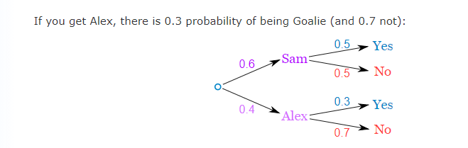
Probability Tree - Example: Soccer Game

Slide 22
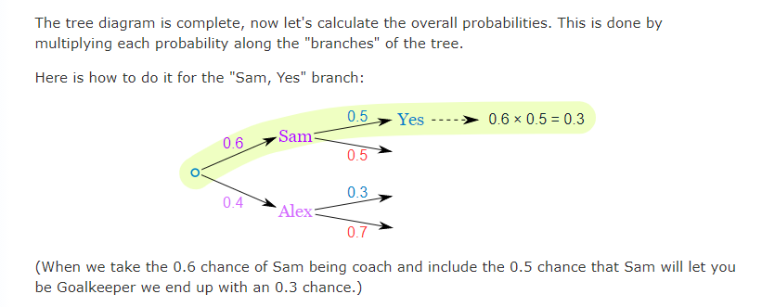
Probability Tree - Example: Soccer Game

Slide 23
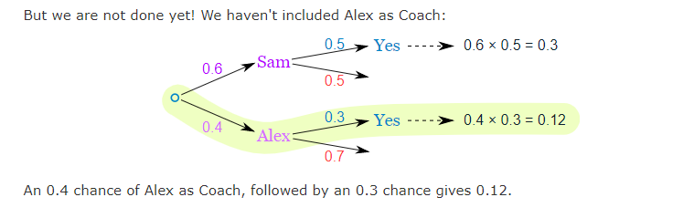
Probability Tree - Example: Soccer Game

Slide 24
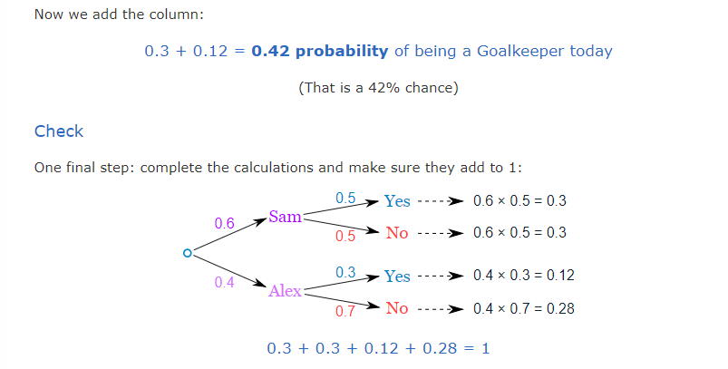
Probability Tree - Example: Soccer Game

Slide 25
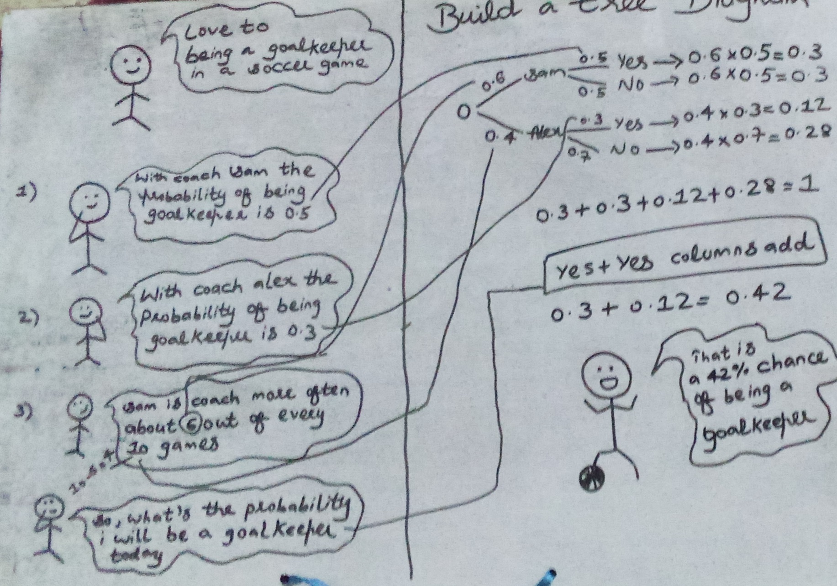
Probability Tree - Example: Soccer Game

Slide 26
Probability Tree – Conclusion
when in doubt draw a tree diagram, multiply along the branches and add the columns.
Make sure all probabilities add to 1 then we are good to go.

Slide 27
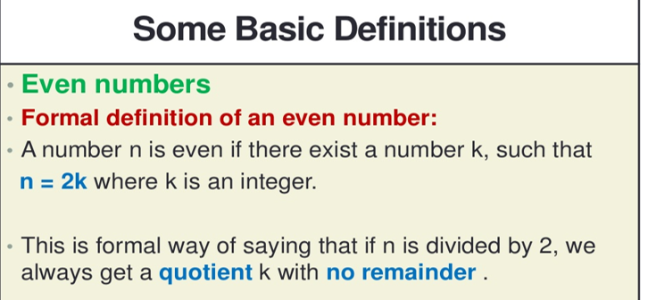

Slide 28
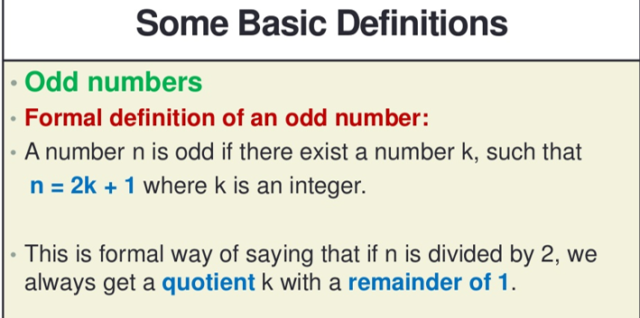


Slide 29
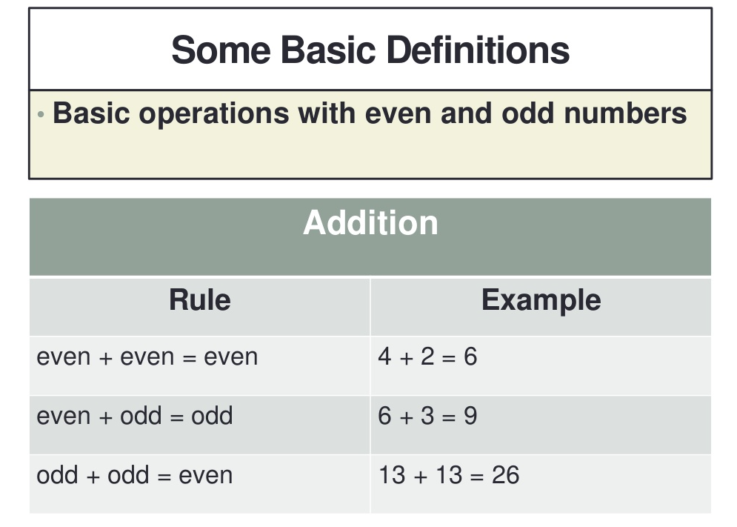

Slide 30
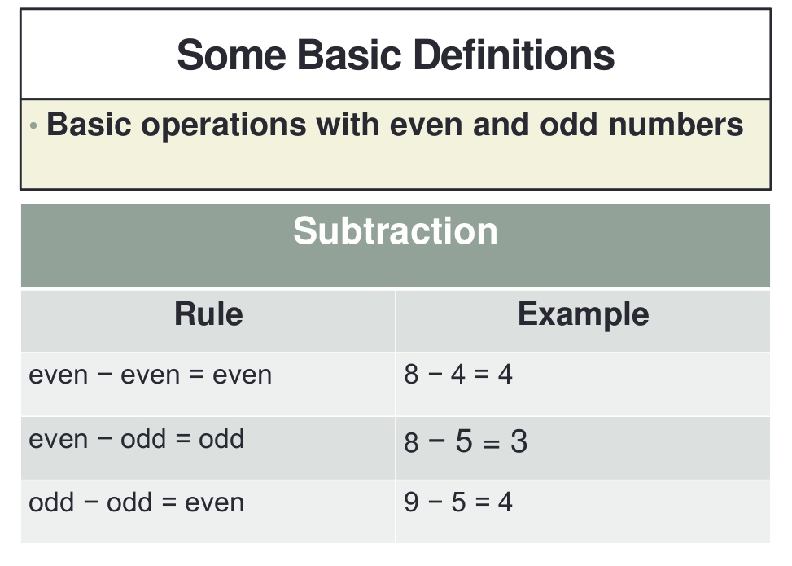


Slide 31
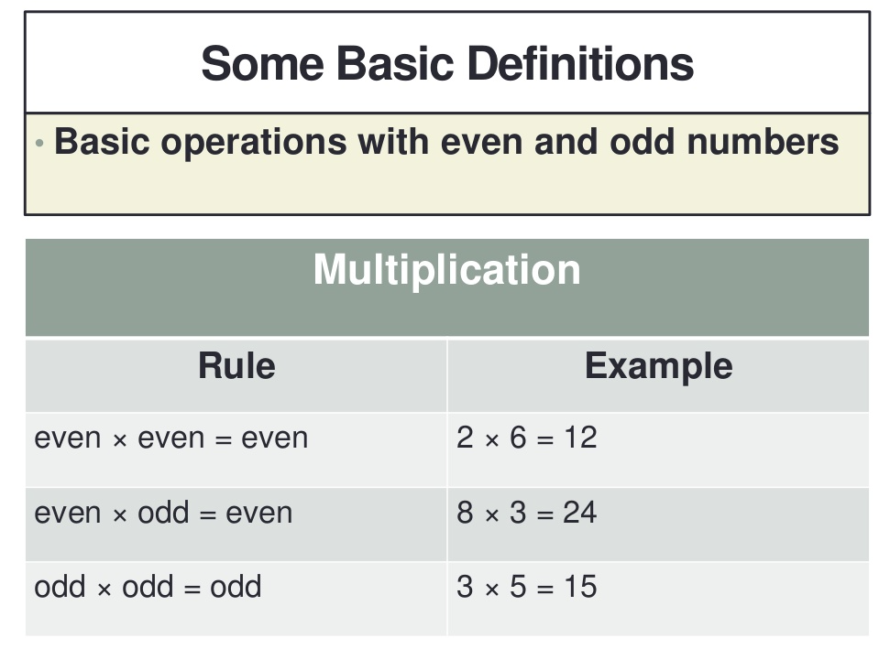

Slide 32
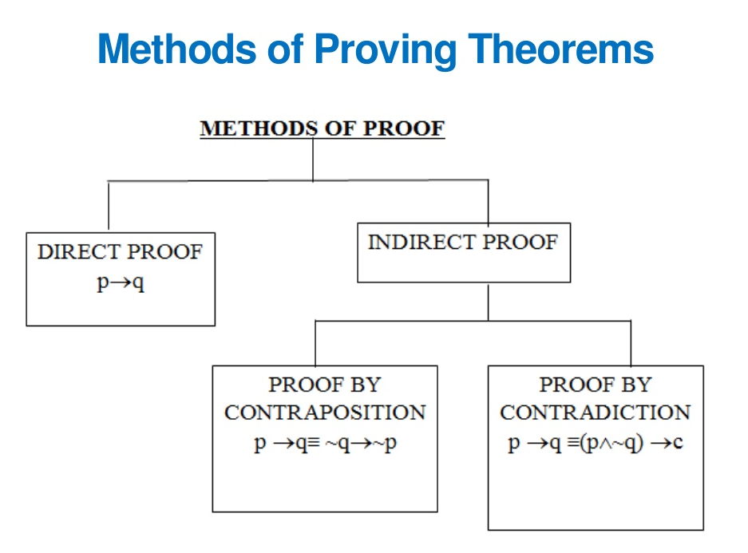


Slide 33
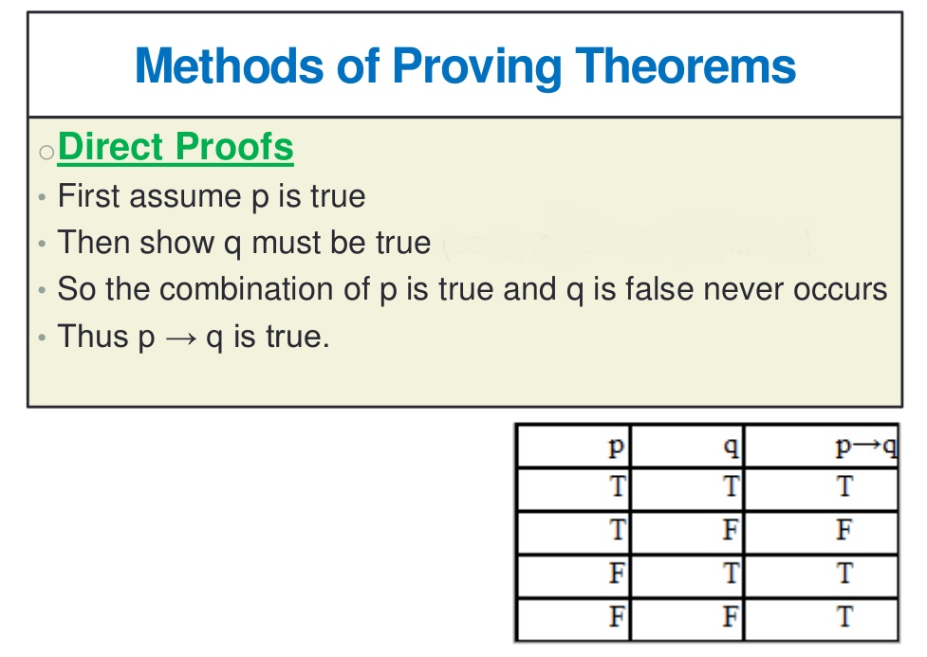


Slide 34
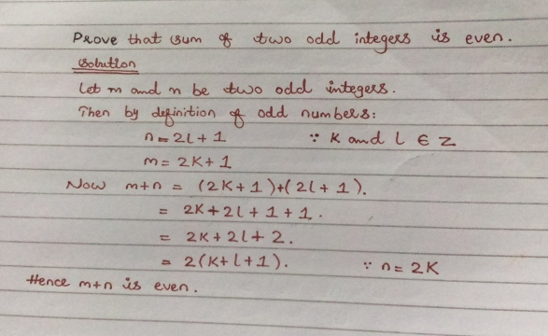

Slide 35
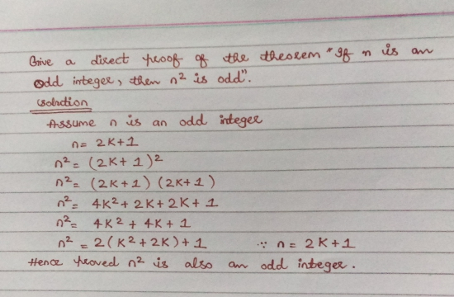

Slide 36
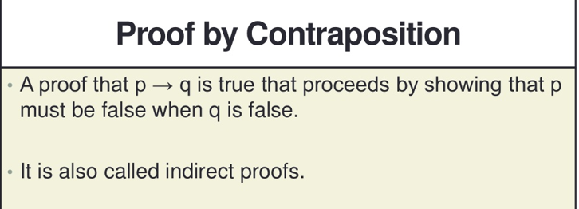

Slide 37
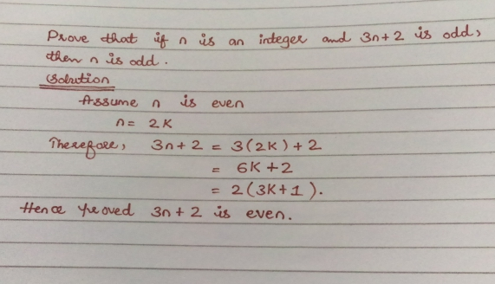

Slide 38
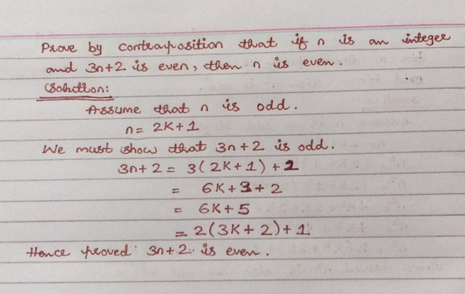

Slide 39
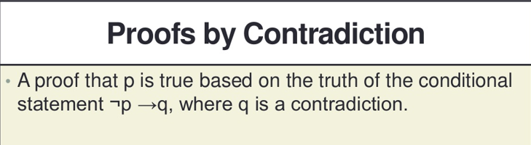

Slide 40
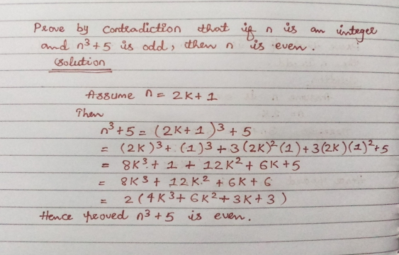

Slide 41
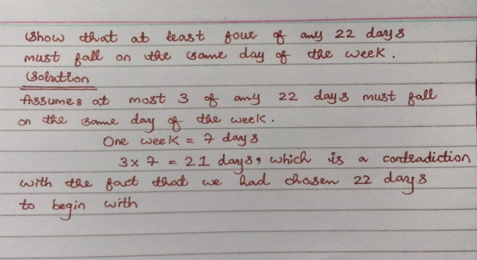


Slide 42
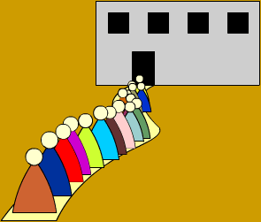
What is Data Structure?
In computer science, a data structure is a data organization, management, and storage format that enables efficient access and modification.

Slide 43
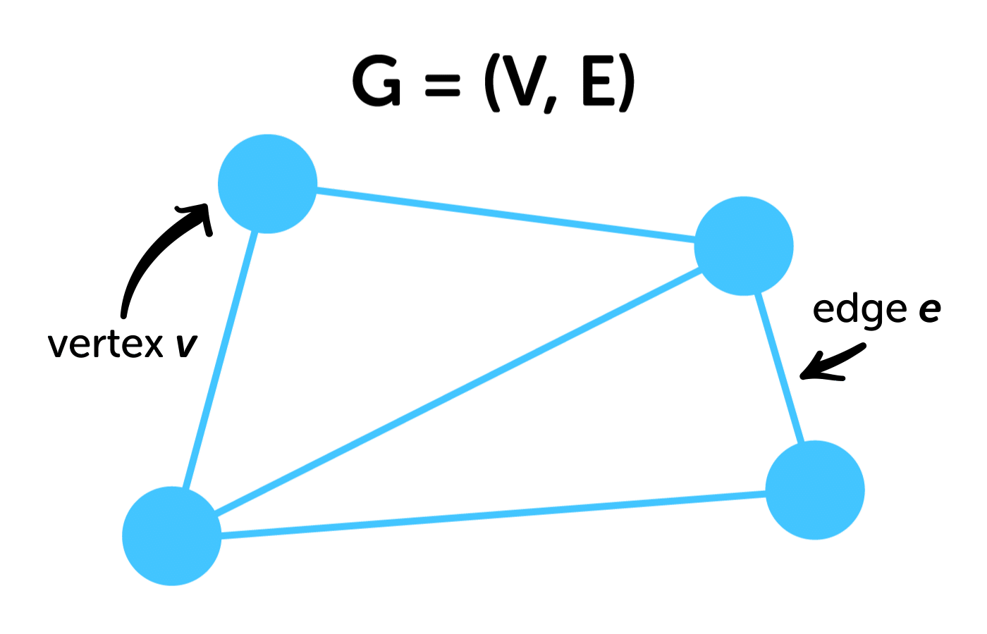
Graph
A graph is a common data structure that consists of a finite set of nodes (or vertices) and a set of edges connecting them.
1) Vertices are nothing but the nodes in the graph.
2) Two adjacent vertices are joined by edges.
3) Any graph is denoted as G = {V, E}.

Slide 44

Graph Example : Facebook
On Facebook, everything is a node. That includes User, Photo, Album, Event, Group, Page, Comment, Story, Video, and Link.
Note: Anything that has data is a node.
Every relationship is an edge from one node to another. Whether you post a photo, join a group, like a page, etc., a new edge is created for that relationship.
All of the Facebook is then a collection of these nodes and edges.
This is because Facebook uses a graph data structure to store its data.

Slide 45
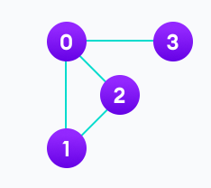
Graph Example
V = {0, 1, 2, 3}
E = {(0,1), (0,2), (0,3), (1,2)}
G = {V, E}

Slide 46
Graph Terminology
Adjacency:
A vertex is said to be adjacent to another vertex if there is an edge connecting them.
For example Vertices 2 and 3 are not adjacent because there is no edge between them.

Slide 47
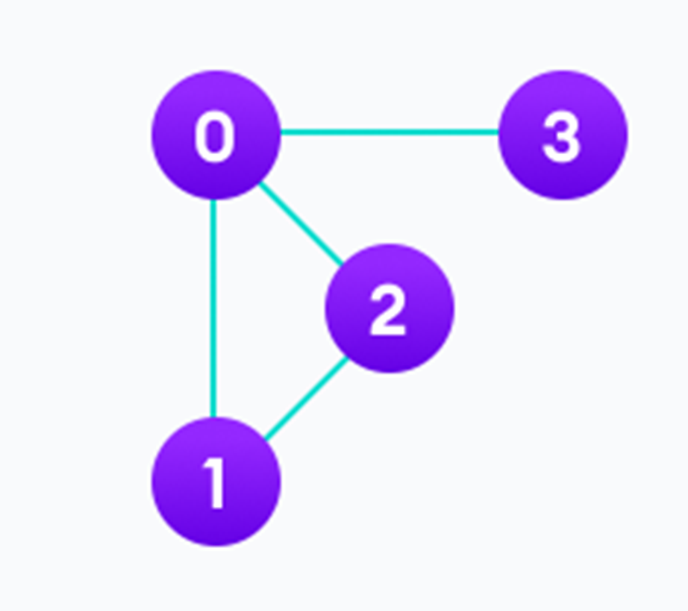
Graph Terminology
Path:
A sequence of edges that allows you to go from vertex A to vertex B is called a path. 0-1, 1-2 and 0-2 are paths from vertex 0 to vertex 2.

Slide 48
Types of graphs:
Undirected Graph
Directed Graph

Slide 49
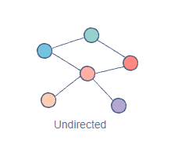
1) Undirected Graph:
In an undirected graph, nodes are connected by edges that are all bidirectional.
For example if an edge connects node 1 and 2, we can traverse from node 1 to node 2, and from node 2 to 1

Slide 50
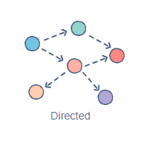
2) Directed Graph
In a directed graph, nodes are connected by directed edges – they only go in one direction.
For example, if an edge connects node 1 and 2, but the arrowhead points towards 2, we can only traverse from node 1 to node 2 – not in the opposite direction

Slide 51
Graph Representation
Graphs are commonly represented in two ways:

Slide 52
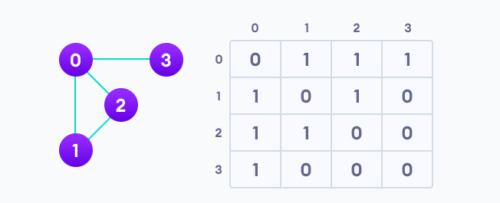
Adjacency Matrix Example

Slide 53
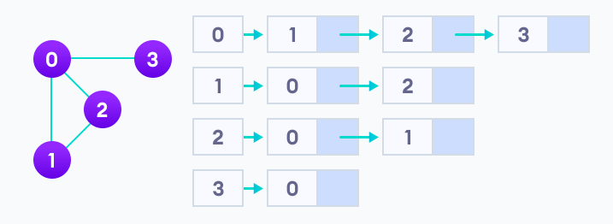
Adjacency List

